Slide 1
Automated Weld Path Generation Using Random Sample Consensus and Iterative Closest Point Workpiece Localization – DETC90082
Tristan Hill
Tennessee Technological University
Stephen Canfield
Tennessee Technological
University
Robert Shelton
Tennessee Technological
University
August 15, 2022
St. Louis, MO

Slide 2
Overview
Motivation – Robotics and Automated Welding
Approach – Workpiece Localization
Results - Simulated and Experimental
Conclusions – Applications and Future Work

Slide 3
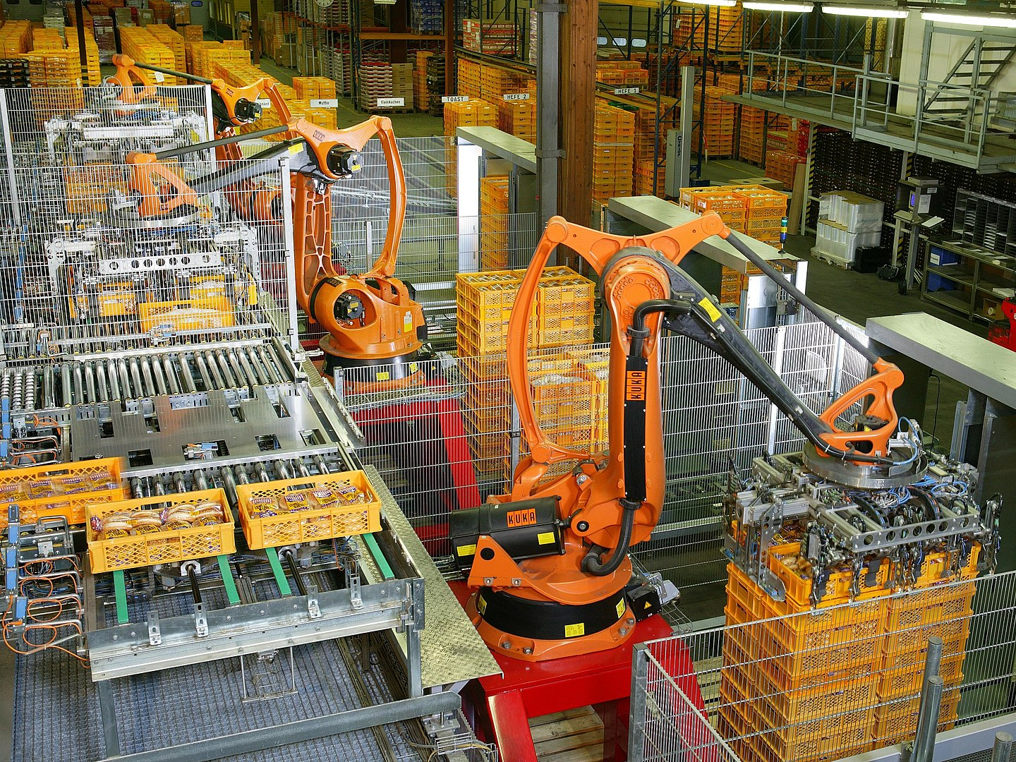
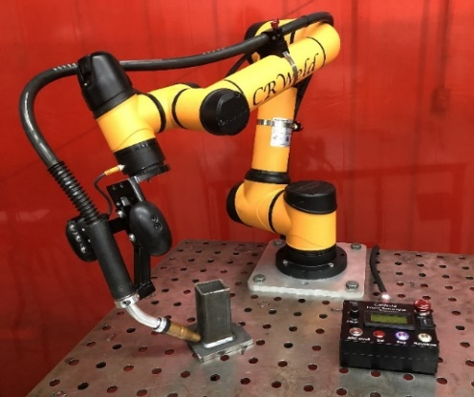
Robotics in Manufacturing
Large Enterprise Production
High part volume
Low to medium tolerances
High overhead
Small to Medium Enterprise (SME)
Low part volume
Medium to high tolerances
Affordable overhead?
Kuka Industrial Robots, Source: Wikipedia
C.R. Weld Cobot, Source: RTT, Robotic Tech. Tenn.

Slide 4
Automated Welding and Tool Path Generation
Automation requires control of tool pose typically achieved using a kinematic model and joint level control.
A spatial description of the desired task is required.
Online Teaching with Pendant
Online Lead Through Teaching
Offline Computer Modeling
The transformation from the manipulator base frame to the frame of the workpiece must be known.
Fixtures or Jigs
Vision and Sensing
Teaching

Slide 5
Literature Review
Workpiece Localization
[29] A. Kuss, U. Schneider, T. Dietz and A. Verl, "Detection of Assembly Variations for Automatic Program Adaptation in Robotic Welding Systems," Proceedings of ISR 2016: 47st International Symposium on Robotics, 2016, pp. 1-6.
[33] J. Gao, F. Li, C. Zhang, W. He, J. He and X. Chen, "A Method of D-Type Weld Seam Extraction Based on Point Clouds," in IEEE Access, vol. 9, pp. 65401-65410, 2021, doi: 10.1109/ACCESS.2021.3076006.
Image Registration
[1] Segal, A. V., Haehnel, D., and Thrun, S., 2010, “Generalized-ICP,” Robotics: Science and Systems.
Point Cloud Library
[5] Rusu, R. B., and Cousins, S., 2011, “3D Is Here: Point Cloud Library (PCL),” Proceedings - IEEE International Conference on Robotics and Automation.
Automation of welding has been a focus of robotics research for many years
Seam Tracking
Start Point Determination
Workpiece Localization
Image registration is a fundamental problem in computer vision and has been studied thoroughly. This field is changing rapidly with technological developments.
Sensing and Data Storage
Computational Abilities
Algorithms and Machine Learning

Slide 6
Contribution
An effective process is shown which uses RANSAC and ICP for workpiece localization from a point cloud data containing outliers for a robotic welding application.
Improve robustness of previous methods in presence of non-correspondence outlier points
Increase accuracy of workpiece localization

Slide 7
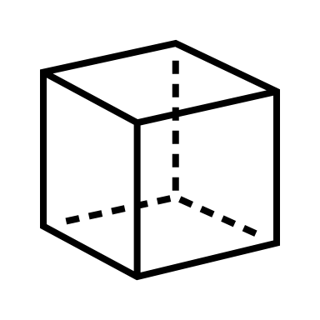



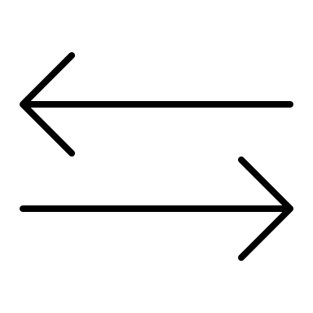

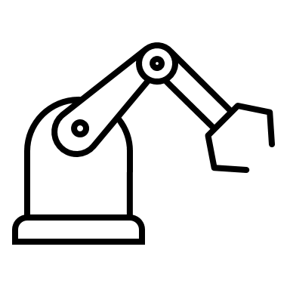
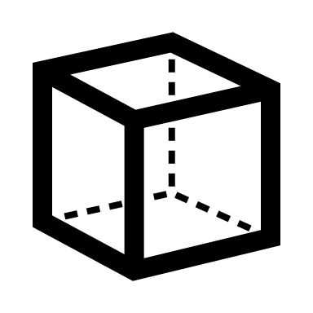
Overview of Approach
The process consists of multiple stages.
1- Model Preparation
2 - Workspace Sensing
3 - Workpiece Localization
4 - Path Generation
Model Preparation
Workpiece CAD
Model Generation
Workpiece Localization
Conversion to
Pointcloud
PassThrough + Voxel Filtering
RANSAC
Segmentation
ICP
Registration
Workspace Sensing
Collection of
2D LiDAR Scans
Conversion to
Pointcloud
Path Generation
Weld Path Construction with LSPB
Projection to workpiece frame

Slide 8
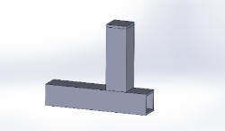
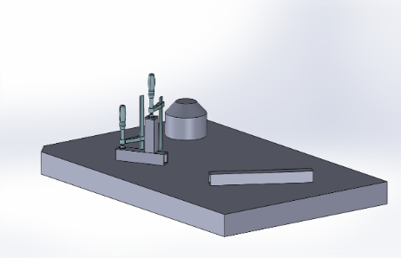
Model Preparation
Workpiece CAD Model Generation
workspace and workpiece is defined from application
workpiece model generated using CAD
Conversion to Point Cloud
3D models generated in standard CAD software
converted to standard polygon files (.ply)
Point cloud from CAD model called source cloud

Slide 9
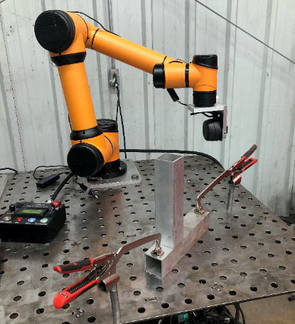
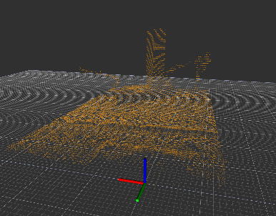
Workspace Sensing
Collection of 2D LiDAR Scans
workpiece placed in robot workspace in the proper relative orientation
a sweeping motion of the arm above table performed
workpiece and environment scanned with the 2D LiDAR mounted on
Conversion to Point Cloud
transformed from sensor frame to base frame through the robot kinematics
Accumulated point cloud from LiDAR scan called reference cloud

Slide 10
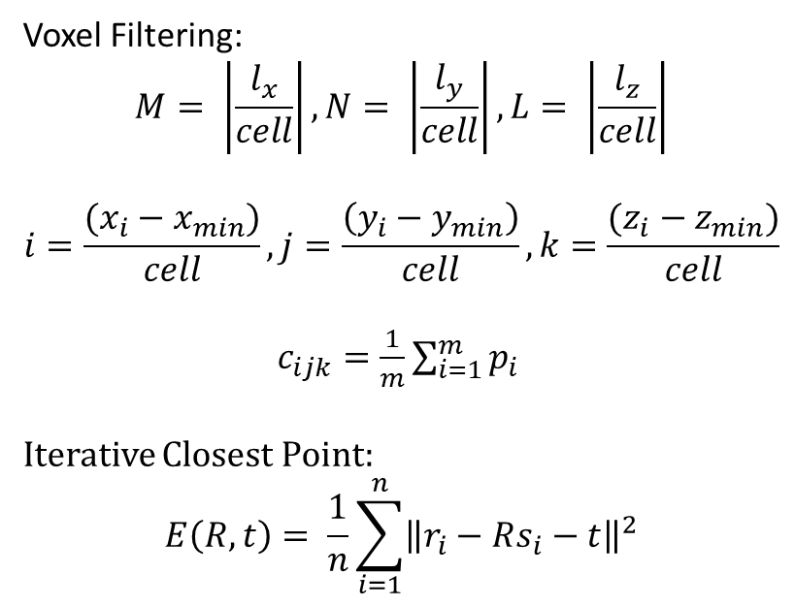
Workpiece Localization
Voxel Filtering:
$$M= \left|\frac{l_{x}}{cell}\right|,N= \left|\frac{l_{y}}{cell}\right|,L= \left|\frac{l_{z}}{cell}\right|$$
$$i=\frac{(x_{i}−x_{min})}{cell}, j=\frac{\left(y_{i}−y_{min}\right)}{cell}, k=\frac{(z_{i}−z_{min})}{cell}$$
$c_{ijk}=\frac{1}{m}\sum_{i=1}^{m}{p_{i}}$
Iterative Closest Point:
$$E\left(R,t\right)= \frac{1}{n}\sum_{i=1}^{n}{{\left\|r_{i}−Rs_{i}−t\right\|}^{2}}$$
Filtering
PassThrough - remove data outside of workspace
Voxel – reduce redundant data
RANSAC Segmentation
Remove non-correspondence points inside the workspace
Table is removed as largest plane
Correspondence points defined from remaining workpiece planes
ICP Registration
source cloud from CAD model compared to reduced reference cloud from LiDAR
transformation between clouds found with iterative closest point (ICP) and interpreted as workpiece pose
fails or converges slowly in the presence of non correspondence

Slide 11
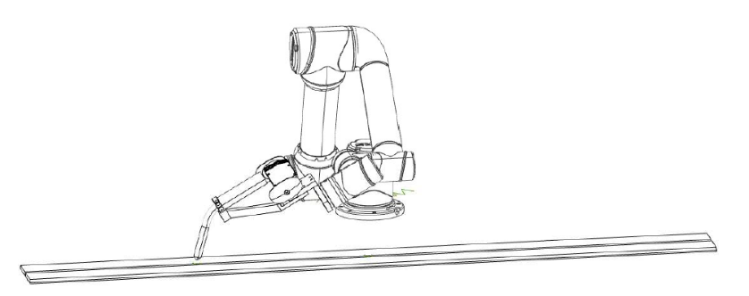
Path Generation
Velocity profiles for 6DOF manipulator determined from localized workpiece geometry
Path construction with LSPB (linear segment parabolic blend)
Kinematic description of robot for projection to workpiece frame
P_{i}
O_{i,i+1}
P_{i+2}
O_{1+1,i+2}
P_{i+1}
θ_{T}
RP
y’, y’’
z_{WP}, z’
θ_{w}
t
z_{T}
x_{T}
z₀
x_{WP}
θ_{w}
θ_{R}
x’
n
y₀
x₀
θ_{T}

Slide 12



Implementation with ROS + PCL
Implemented in ROS on Ubuntu Linux
2D LiDAR scans combined into 3D point clouds with custom ROS package scan2cloud based on ROS laser_geometry (https://github.com/thillRobot/scan2cloud.git)
Primary approach in a custom ROS package seam_detection that uses PCL (https://github.com/thillRobot/seam_detection.git)
Email: thill@tntech.edu for questions or sharing
PCL, source: pointclouds.org
Tux, source: Wikipedia.org
ROS, source: wiki.ros.org

Slide 13
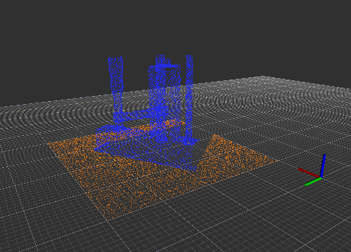
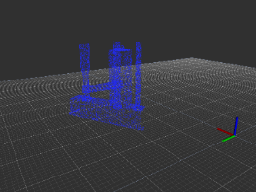
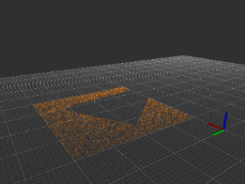
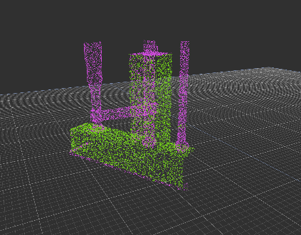
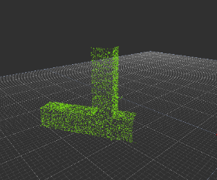
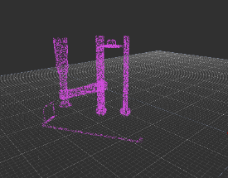
Simulation Results
The process was first completed on synthetic data. The source and reference clouds were both generated from CAD.
FIGURE 4: SEGMENTATION TO REMOVE TABLE
FIGURE 5: SEGMENTATION TO REMOVE CLAMPS

Slide 14
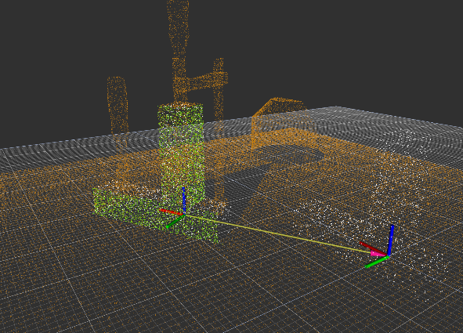
Simulation Results
TABLE 1: SIMULATION RESULTS – EXAMPLE APPLICATION
 | Roll (rad) | Pitch (rad) | Yaw (rad)
Expected Rotation | 0.0 | 0.0 | 0.52360
Measured Rotation | -0.00918 | -0.00681 | 0.52759
Difference | 0.00918 | 0.00680 | -0.00399
` | X(m) | Y (m) | Z (m)
Expected Translation | 0.25 | 0.2 | 0.025
Measured Translation | 0.251347 | 0.19923 | 0.02436
Difference | -0.00134 | 0.00077 | 0.00064
FIGURE 6: SIMULATED APPLICATION – WORKPIECE REGISTRATION

Slide 15
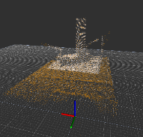
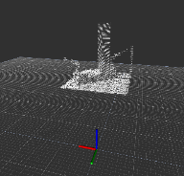
Experimental Results
The approach was tested using a Aubo i5 cobot and an RPLiDAR A2 on a welding table courtesy of RTT – Robotic Technologies of Tennessee and Stephen Zuccaro.
FIGURE 7: BOUNDING BOX
FIGURE 7: EXPERIMENTAL EXAMPLE APPLICATION

Slide 16
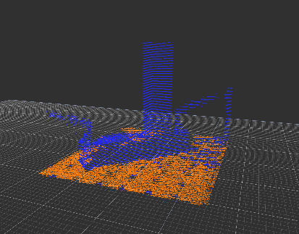
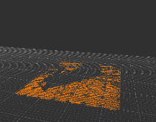
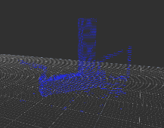
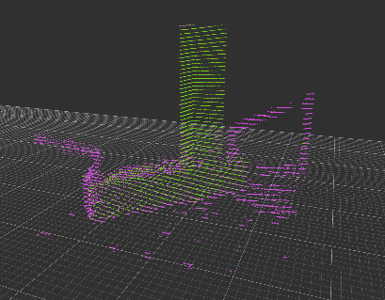
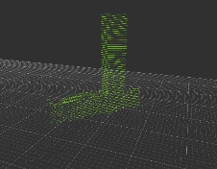
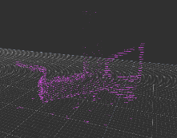
FIGURE 8: SEGMENTATION TO REMOVE TABLE
FIGURE 9: SEGMENTATION TO REMOVE CLAMPS

Slide 17
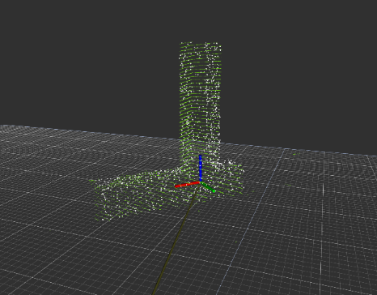
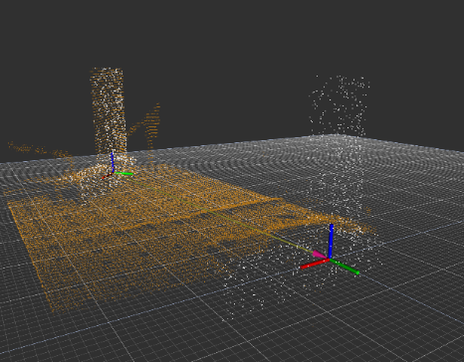
Experimental Results
FIGURE 10: EXAMPLE APPLICATION – WORKPIECE REGISTRATION
TABLE 3: EXPERIMENTAL RESULTS - EXAMPLE APPLICATION
 | X (m) | Y (m) | Z (m)
Expected Translation | 0.10160 | -0.60960 | 0.02540
Measured Translation | 0.10840 | -0.61096 | 0.02034
Difference | -0.00680 | 0.00136 | 0.00506
 | Roll (rad) | Pitch (rad) | Yaw (rad)
Expected Rotation | 0.0 | 0.0 | 0.785
Measured Rotation | -0.00457 | 0.02186 | 0.79461
Difference | 0.00457 | -0.02186 | -0.00921293

Slide 18
Conclusion
The results show that the proposed method of automated weld path generation using RANSAC and ICP algorithms is viable for workpiece localization.
Development is required to make the method generalized to different part geometries and conditions
Implementation of the full process including performing the weld is the next step.
Investigation of machine learning approaches to address problems with ICP is a future goal.

Slide 19
Questions?

